Slide 1

An introduction to forecast evaluation with Stata
By
Robert A. Yaffee, Ph.D.
Research Professor/Research Scientist
Silver School of Social Work
New York University
Stata Users Group Conference
London School of Hygiene and Tropical Medicine
September 8-9, 2010

Slide 2
Acknowledgments
The writings of Sir David Hendry, Jurgen Doornik, Hans-Martin Krolzig, Clive Granger, Paul Newbold, Jenny Castle, Spyros Makridakis, Sebastien Laurent, Steven Wheelwright, Victor McGee, James Durbin, Siem Jan Koopman, Andrew C. Harvey, Robert Fildes, Robert Engle, Neil Ericsson, Neil Shephard, Halbert White, Keith Ord, Anne Koehler, David Reilly, Fred Joutz, Michele Hibon, Ralph Snyder, Scott Armstrong, Herman Stekkler, Richard McClary and Robert Hay as well as Robert Hyndman greatly enhanced my interest in forecasting.
When in 2001 I was asked by the special pathogens branch of the CDC to help them in a forecasting project, one of the first things I did was to perform a comparative reliability analysis of several statistical packages with forecasting capability. Stata was one of the reliable ones.
.

Slide 3
Acknowledgments-cont’d
Stata personnel along the way has been extremely helpful. Bill Gould, Vince Wiggins, David Draper, Brian Poi, Robert Guiterrez, Jef Pitblado, Kerry Kammire, Bill Rising, Alan Acock among others have been very supportive and helpful.
This endeavor led to a perusal of some excellent writings of Sophia Rabe-Hasketh and Anders Skrondall, Chris Baum, Nick Cox, Michael Mitchell, Sven Juul, James Hamilton, Colin Cameron and Pravin Trivedi, Joseph Hilbe and James Harden, amongst others that have endowed me with a deeper appreciation of Stata.
At an International Symposium on Forecasting conference in Merida, Mexico, Anna Timberlake asked me if I would like to teach the subject and I have been doing so ever since.
Along the way, Peg, Young, Andy Hopkins, James Mills, Kent Waggoner, Ken Abbott, Sjur Westgaard, Richard Douglass, David Reilly, Kostos Nikolopoulis, Sven F. Crone, Brian Amman, Merrill Heddy, Monnie McGee, Ben Jann, Chris Baum, Stephen Jenkins, and Pat Roysten, Ed Melnick, Cliff Hurvich, Rohit Deo, Makram Talih, Dana Draghicescu, Marc Scott, Danny Gammerman, Andrew Lawson, Mark Little, Mike Leonard, Donna Woodward, Leonardo Auslender, and Talbot Katz, among others have helped further motivated my and interest and involvement. To all of these people interest I am grateful.
I must also express a debt of gratitude to the National Science Foundation for supporting Rosemarie Perez-Foster, Thom as Borak, Victor Chtengulov, Gleb Priv and myself in our study of the long-run effects on the Chernobyl survivors. To avail ourselves of the wide variety of all statistical techniques we are using multiple statistical packages on this project and Stata is one of them.

Slide 4
Outline
Motivation
Nomenclature
Research study design
ARIMA model forecast evaluation
Directional accuracy
Elements of forecast rationality
Measures of accuracy
Absolute
Relative

Slide 5
Motivation
Box’s Law: George E. P. Box is reported to have maintained that “All models are wrong, but some are useful (Box and Draper, 1987).”
All models are measured with error. Michael Clements and Sir David Hendry (2001) suggest some reasons why conditional models, misspecified in unknown ways yield model error.

Slide 6
Clements and Hendry (2001)
A model is an attempt to extract regularities while excluding irregularities from nature.
Although modeling and forecasting require covariance stationarity, “we live in a nonstationary and changing world (Clements and Hendry, 2001).”

Slide 7
Our modeling theory, from which we derive our forecasts, must allow for “intermittent structural breaks” (ibid,2).
The data generating mechanism, from which our time series realization stems, can change over time. Furthermore, some DGPs change more rapidly than others.
Shifts in deterministic factors can cause shifts in equilibrium means over time.

Slide 8
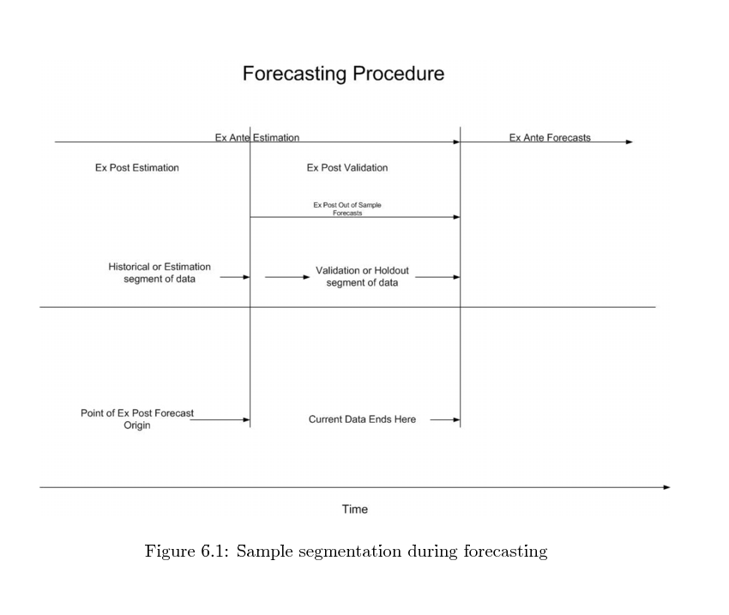
Preparations for prediction (Pindyck and Rubenfeld, 1997)
Ex ante
Forecast horizon
Ex post forecast
horizon

Slide 9
Data preparation
Transformation to covariance stationarity
Stable mean, variance, and autocorrelation throughout the series
Detrending may be done with regression on time trends or by differencing (sometimes double differencing (Hendry and Clements, 1999; Hendry and Castle, 2008).
Level shifts and outliers should be modeled. This requires a new level of diagnosis– called outlier and l regime shift analysis. The search for structural breaks must be included as part of the diagnosis of the model.
Intercept corrections may be necessary if there are level shifts in the series.

Slide 10
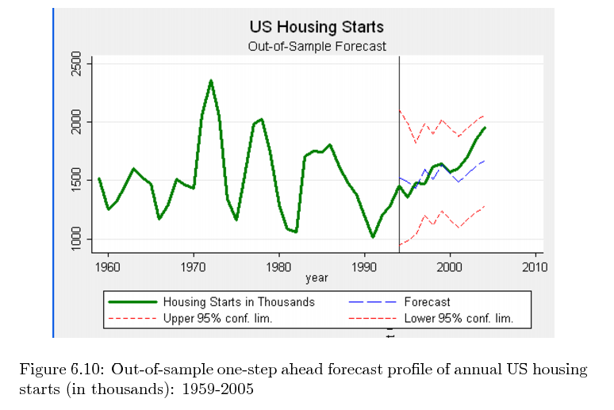
Ex post unconditional forecast may be good for policy analysis and evaluation.

Slide 11
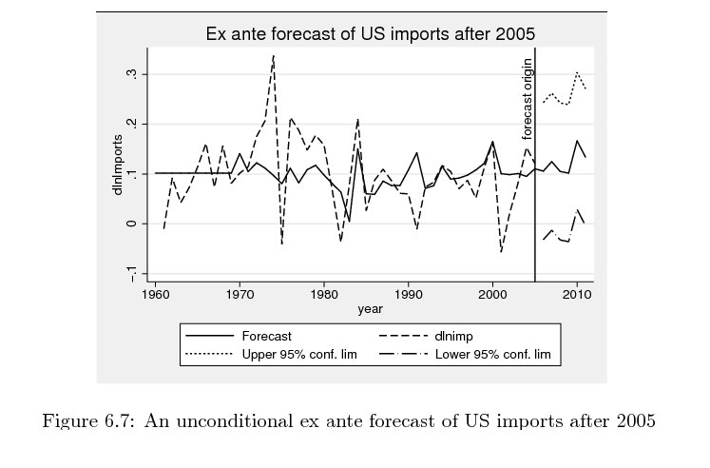
An unconditional ex ante forecast
Preferred over ex post forecasts for assessing accuracy

Slide 12
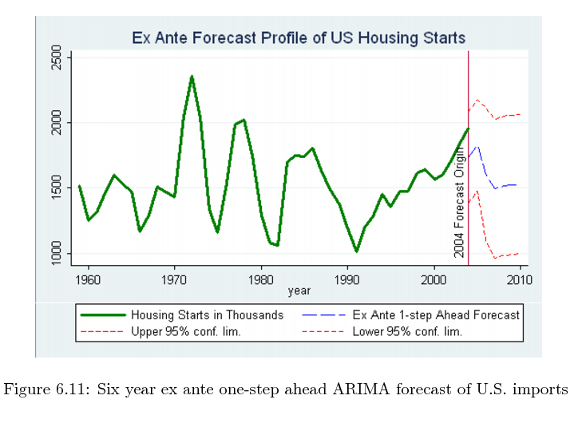
One-step ahead forecast often used as a test of forecast accuracy

Slide 13
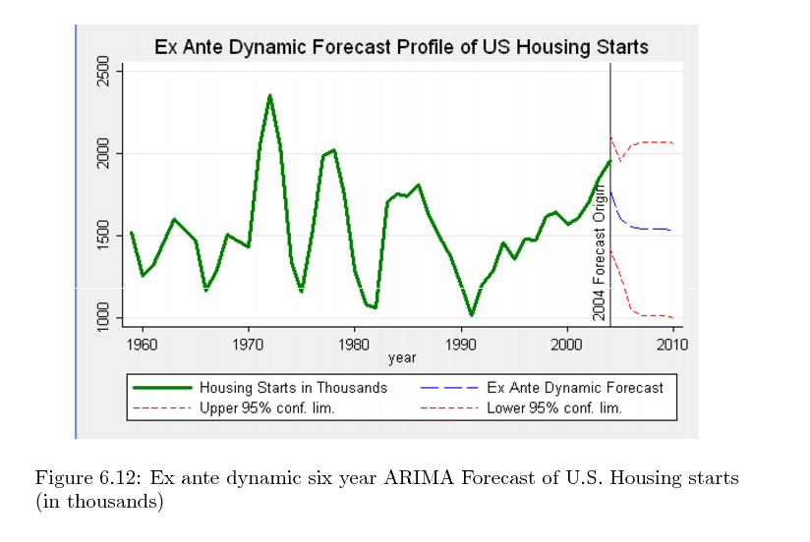
Dynamic multi-step ahead forecasts

Slide 14
Models often imply system closure
When the system is not as closed as the models imply, there may be unanticipated impacts from changes in other fields owing to innovations, discoveries, interactions and correlations with legislative, administrative, or policy changes.

Slide 15
Conditional and unconditional forecasts
“Predictability is necessary but not sufficient for forecastability (Ibid,8).”
Forecastability requires not only a systematic relationship but a knowledge of how the information set enters the conditional density of the data generating process (Ibid,8).
Misspecification can arise there due to hidden or unanticipated correlations with excluded or unknown variables but they may also come about due to unanticipated changes in variables over the forecast horizon.

Slide 16
Simple forecasting methods ofte outperform complex models
Simple non-causal methods may forecast more accurately than more complex causal models.
E.g., some exponential smoothers have outperformed more complex models in the international M-3 forecasting competition.
The Theta model (Assimikopoulis and Nikolopoulos ) won M-3 a few years ago:

Slide 17
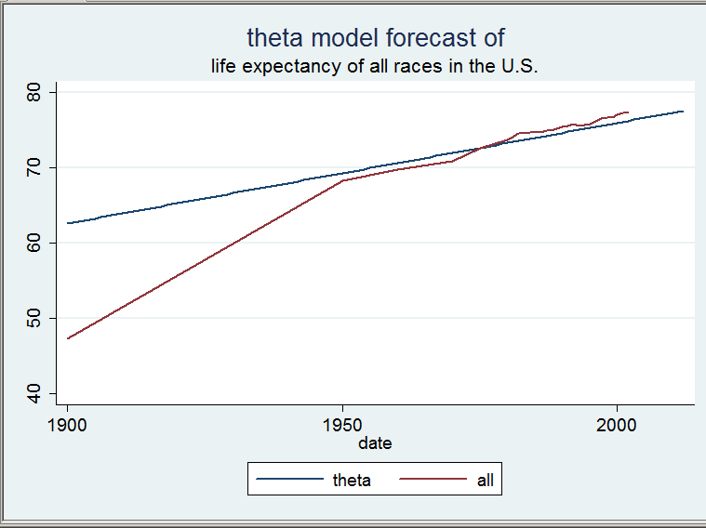
A theta forecast

Slide 18
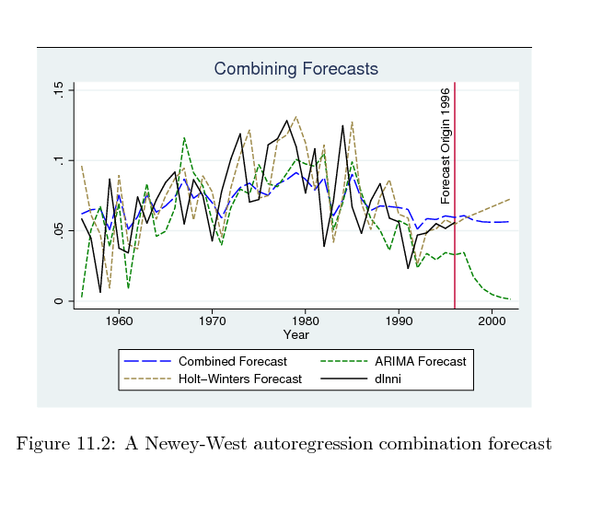
Optimal forecasting by combining different forecasts

Slide 19
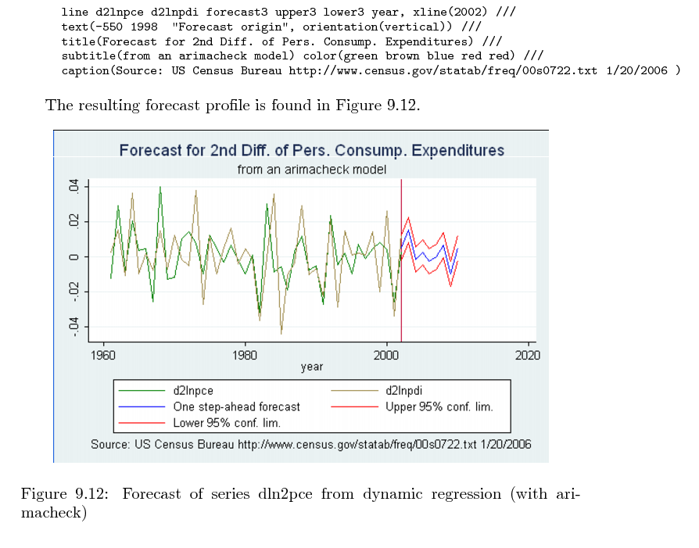
Conditional forecast

Slide 20
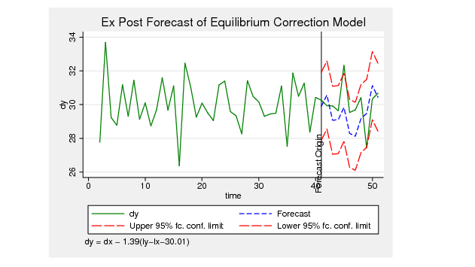
Forecasting cointegrated models

Slide 21
ARIMA forecast evaluation
In this presentation, I concentrate on ARIMA forecasts.
To do so, I must turn our attention to some nomenclature and some counterintuitive definitions of key organizing concepts.

Slide 22

Nomenclature
Forecast error = actual value – forecast value
Optimal forecasts: forecasts that deliver minimum error variance over the forecast horizon. How do we measure this?
Forecast horizon = number of periods beyond forecast origin over which series is forecast
SSFE = [forecast error - mean(forecast error)] ²

Slide 23
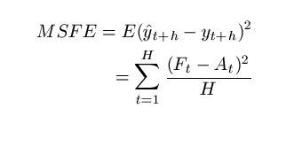
Forecast error variance
MSFE = SSFE/h , where h= length of forecast horizon
Although this is the criterion of optimality, Armstrong(2000) maintains that it is unreliable when there are mistakes or outliers in the series. He warns against using it.

Slide 24
Clarifying the frame of reference
Out of sample forecast is really an “out-of estimation-sample forecast (Sir David F. Hendry, 2004).” This kind of forecast is called an ex post forecast.
Ex ante forecasts are really the forecasts beyond the range of the available data.

Slide 25
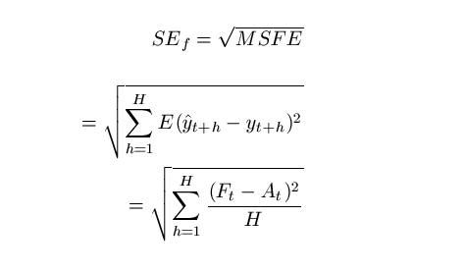
Forecast standard error (root mean square error)
Similarly, Armstrong warns against using this as well.

Slide 26

Forecast confidence intervals under the working assumption of normal distribution of the residuals

Slide 27
Caveat: the residual distribution may not be normal
the classical assumption of normality may be inappropriate
Do not assume normality without testing for it in the residuals.
If they are not normal, use another distribution for analysis.
Often a t distribution provides a reasonable alternative.
With financial data, we find that the distributions of residuals are fat-tailed, leptokurtotic, and often mean-reverting over time.
t distributions with less than 6 degrees of freedom are sometimes more appropriate to define these leptokurtotic distributions. James Davidson suggests the hyperbolic distribution for analyzing volatility.
In biostatistics, log-normal, exponential, Weibull, Gamma, Frechet, Gamma, Pareto, and Generalized Error distribution may be the one to use.

Slide 28
ARIMA models
Ex post forecasts can be compared to the real data that are available at the same time.
One way is to determine the forecast bias, sometimes called the forecast error, which is simply a test of whether there is a significant difference between the forecast and the actual data over the whole forecast horizon.

Slide 29
The optimal forecast generates the minimum sum of squared errors
This criterion, which has been used conventionally for more than half a century does not penalize the model for complexity.
Information criteria do that. I will present two versions of four information criteria that are commonly used. There are other good ones beyond the temporal scope of this presentation.

Slide 30
Most common are the AIC and BIC
The Akaike information criterion is one of the most common:

Slide 31

AICC Cliff Hurvich & Ruey Tsay
The AIC corrected or AICC attempts a finite sample correction to the degrees of freedom for time series models.

Slide 32
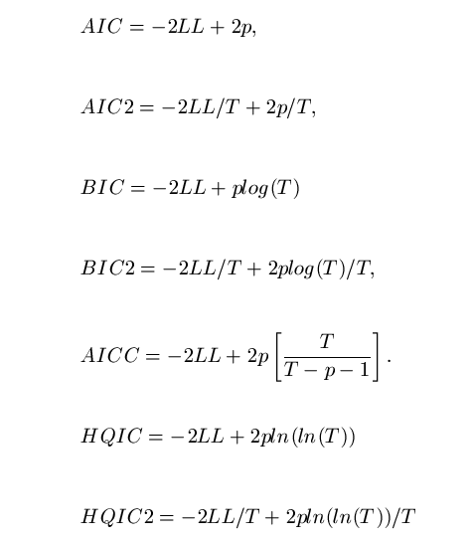
ic.ado reports the following Information criteria after you run your model

Slide 33
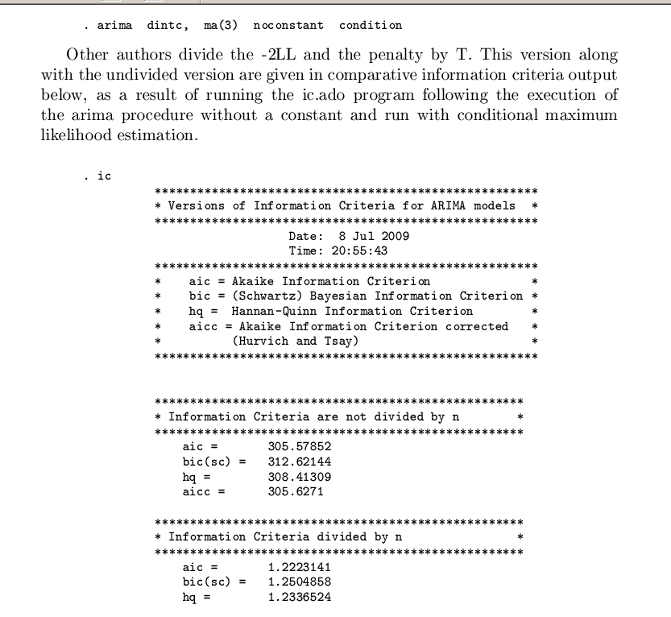
Example of ARIMA model and information criteria output

Slide 34
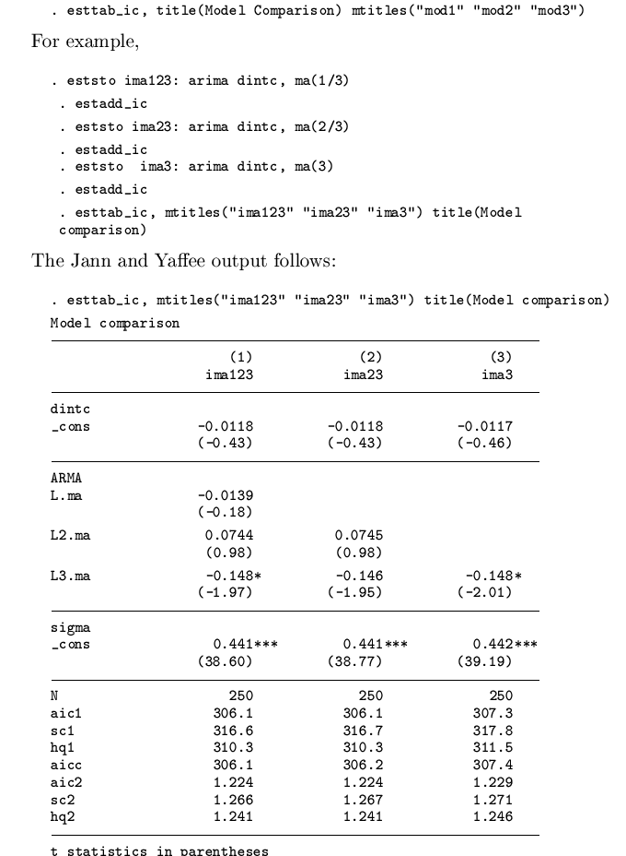
Ben Jann helped me incorporate these into his program estab_ic.ado

Slide 35
Are the residuals well-behaved?
Are the observations sufficiently independent of one another. We use the runtest to ascertain whether they are independent.
Runtest residuals where H0: they are independent of one another.
The portmantau Q test can be used to ascertain whether they are normally distributed and free of systematic variation.

Slide 36
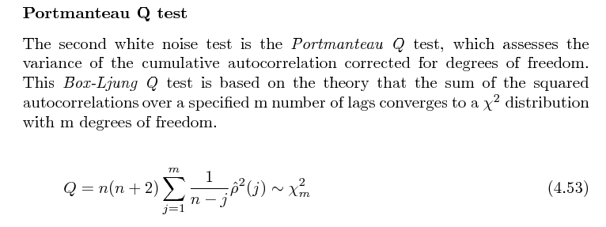
White noise test of residuals
Stata command: wntestq residual, lags(40)

Slide 37
Graphical normality tests
Suppose we have saved the residuals and called them residuals.
Histograms:
hist residuals, normal
Qnorm plots:
Qnorm residuals
Stem and leaf plots:
Stem residuals

Slide 38
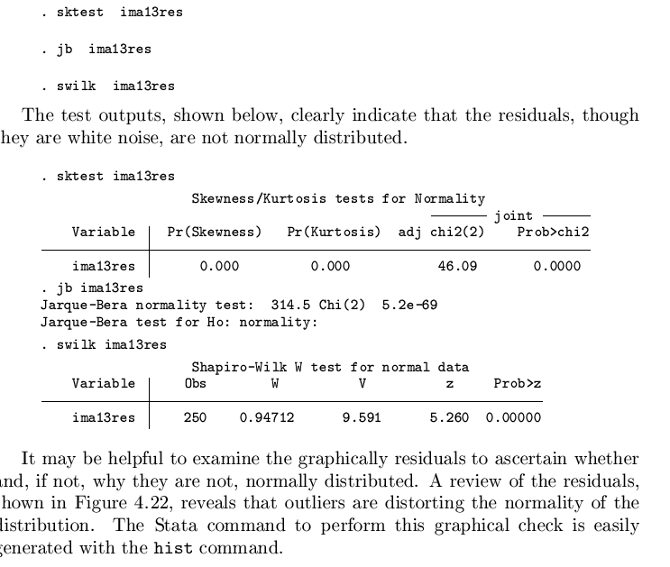
Normality diagnosis

Slide 39
Homogeneity tests with Tsayvar.ado Brian Poi wrote this.
Ruey Tsay’s variance diagnosis
Segment the series
Compute the variance of each segment
Divide the smallest into the largest
This yields a Box’s F test.
Check it for significance.
H0: homogeneity of variance along the series
Graph with box plots
Chow test for structural breaks

Slide 40


Bayesian model averaging
Bates and Granger suggested this upper approach in 1969.

Slide 41
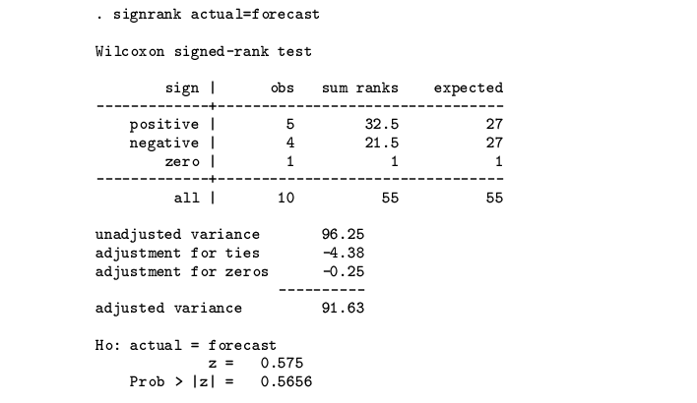
Testing for Forecast bias

Slide 42
Caveat encore
Short forecast horizons are often associated with weak power to distinguish one from the other.

Slide 43
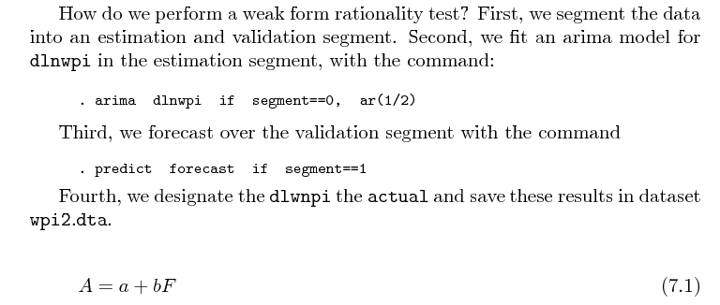
Theil’s weak form rationality test

Slide 44
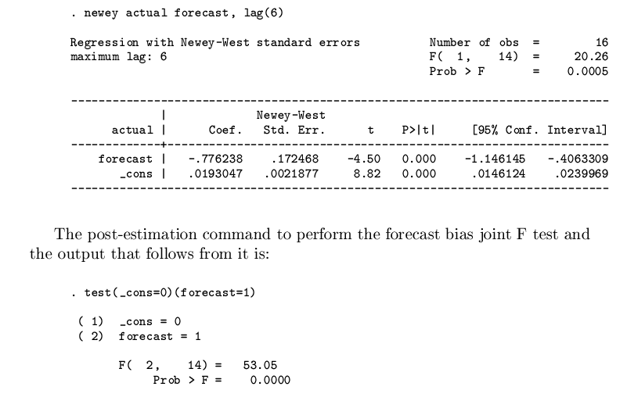
Newey-West regression and joint linear combination test afterward

Slide 45
Measures of Forecast accuracy
We covered the sum of squared errors
The root mean square error is simply the error variance, which was mentioned.
Because of the quadratic power applied, msfe permits outliers and mistakes to distort the mean. Hence, these conventional measures have drawbacks.
To overcome these disadvantages, the MAE, MAPE, and sMAPE are sometimes used.

Slide 46
Problems with the original standard of optimal forecasts
The error variance or mean square forecast error has been shown to be an unreliable criterion by which to judge forecasts.
Armstrong (2000) maintains that this criterion is unreliable as a measure of forecast accuracy (459).

Slide 47
Directional accuracy
The proportion of correct directional forecasts is the directional accuracy. It is a measure of the monotonicity of the forecast with the actual (in the ex post forecast) or the baseline standard of comparison (in the ex ante forecast) over the forecast horizon.

Slide 48
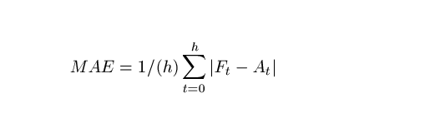
Mean absolute error
This has no standard scale. It is not as comparable as a percentage. While this is a useful tool by which to compare forecasts, it may not be helpful unless you are doing both forecasts to be compared.

Slide 49
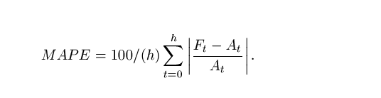
Mean Absolute Percentage error (MAPE)
This puts things on the same scale to render them comparable.
However, it is scale dependent. Using it for forecasts of small numbers warps this out of its utility, unless we use the MAE with it.

Slide 50
Symmetric Mape (sMAPE)
To overcome the scale dependency of the MAPE to small values, the symmetric MAPE has been suggested.
There are at least three versions.
These three versions are displayed on the next page.

Slide 51
Three versions of sMAPE

Slide 52
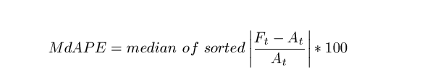
Median absolute percentage error
This is not sensitive to mistake and outliers. If the series has a fair amount of outliers, this may be a good criterion to use.

Slide 53
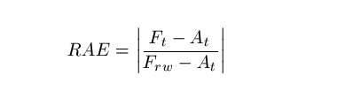
Relative Absolute error
This is a relative measure. The baseline comparison is that of the random walk.
This has an advantage of providing its own baseline so it can be used for ex ante forecast evaluation where other measures may not be so accommodating.
Less than 1 is what you want. Smaller values are preferred to larger ones.

Slide 54
Median relative absolute error
The midpoint of the sorted RAE for each period of the forecast horizon.

Slide 55
RAE plus
The baseline may be naïve one or naïve two forecasts.
Naïve one: the last value carried forward or random walk.
Naïve two: deseasonalized baseline random walk.

Slide 56
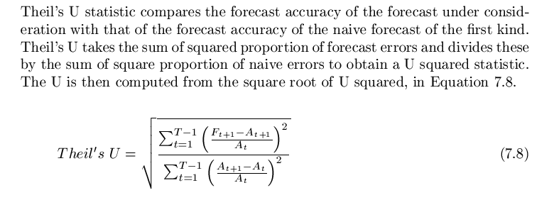
Theil’s U

Slide 57
Percent better than the naive
This is a robust measure.
It is simple.
It is useful for both ex post and ex ante forecasts.

Slide 58
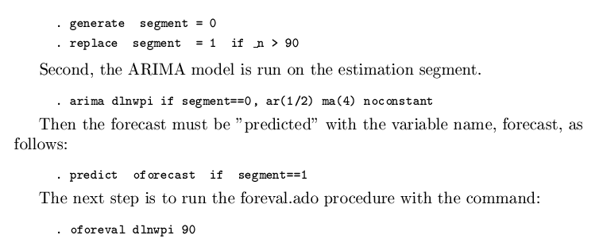
For out of sample forecast evaluation use Oforeval.ado
Preparations are simple:

Slide 59
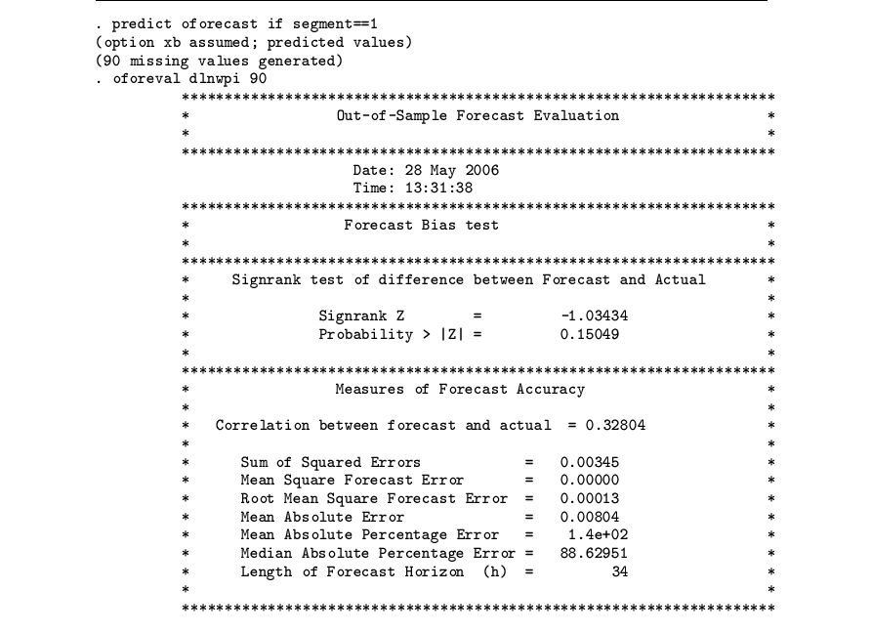
After running the ARIMA model:

Slide 60
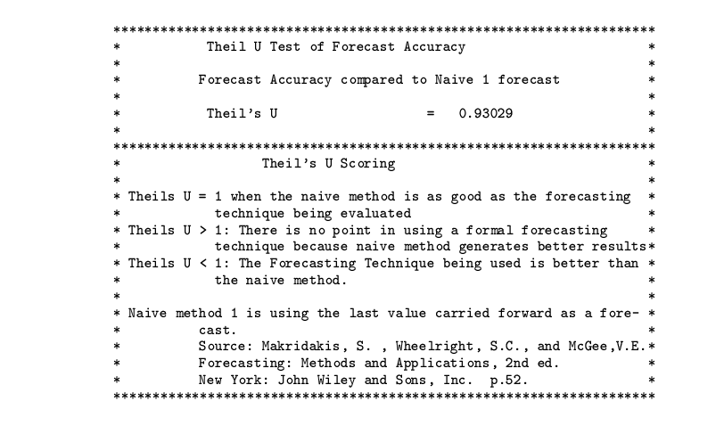
Page two of forecast evaluation output

Slide 61
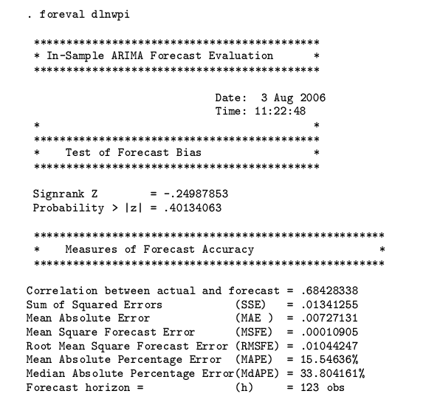
In sample forecast evaluation and ex ante comparison

Slide 62
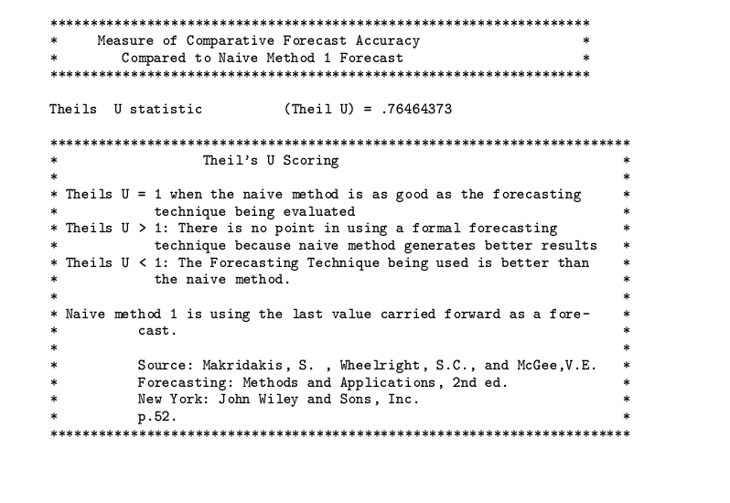
Page two of output for in-sample forecast evaluation

Slide 63
References
Armstrong, S.,(2000) Evaluating Forecast Methods in Armstrong, S.(ed.) Principles of Forecasting, North-Holland, 459.
Baum, C. (2009) An introduction to Stata programming, College Station, TX: Stata Press.
Cameron, A.C. and Trivedi, P.K. (2009). Microeconometrics using Stata. College Station, TX: Stata Press, chapters 4, 10, and 13.
Castle, J. and Shephard, N. (2010).
Doornik, J. A. and Hendry, D. F. (2004). Econometric Modeling with PcGive, Vol I, London, UK: Timberlake Consultants, Ltd., other ic formulae are taken from here.
Hendry, D. F. and Castle, J. ISF2008 presentation in Nice France.
Clements, M.P. and Hendry, D.F. (2001) Forecasting Non-stationary Economic Time Series, Cambridge, MA: MIT Press, xxv, 4-35.
Pindyck, R. and Rubenfeld, D. (1997) Economic Models and Economic Forecasts. McGraw Hill/Irwin: New York, NY.
Yaffee, R. A. An Introduction to Time Series Analysis using Stata, in prep, source of graphs and equations.

